Slide 1
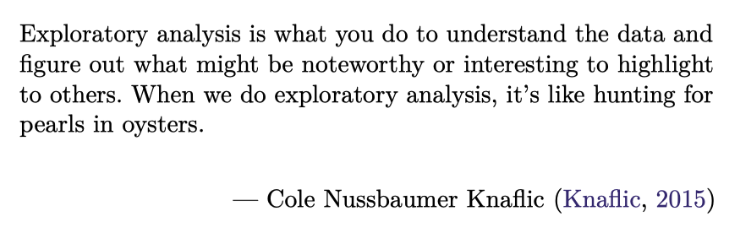
Data Science for Operational Researchers using R
09 – Exploratory Data Analysis
https://github.com/JimDuggan/explore_or

Slide 2
Exploratory Data Analysis
Exploratory data analysis (EDA) involves reviewing the features and characteristics of a dataset with an “open mind”, and is frequently used upon “first contact with the data” (EDA, 2008).
A convenient way to pursue EDA is to use questions as a means to guide your exploration, as this process focuses your attention on specific aspects of the dataset (Wickham et al., 2023).
An attractive feature of EDA is that there are no constraints on the type of question posed, and therefore it can be viewed as a creative process

Slide 3
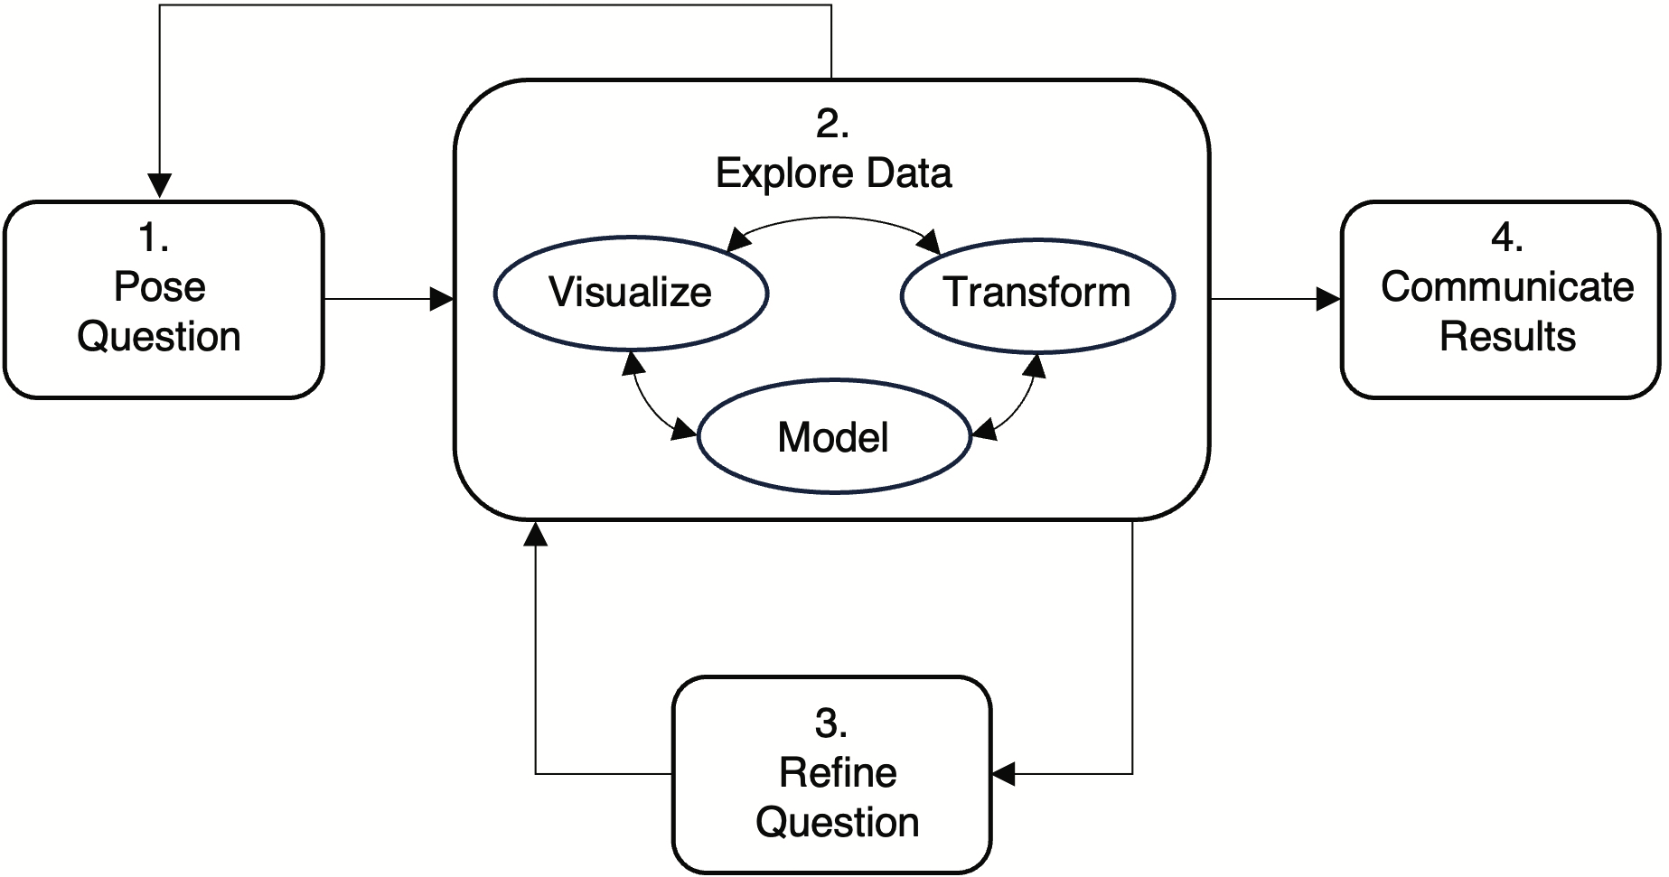
Process for EDA
Can a plant’s dimensions help us uniquely identify a species?
Based on observations from 2012, 2013, and 2014, is there a potential association between temperature and energy demand in the state of Victoria, Australia?
For a Boston dataset from the 1970s, can we find possible relationships between house value and pupil–teacher ratios across different suburbs?
What passengers had the greatest chance of survival on the Titanic?
During the winter season in Ireland, is there initial evidence to suggest that wind direction has an impact on temperature?

Slide 4
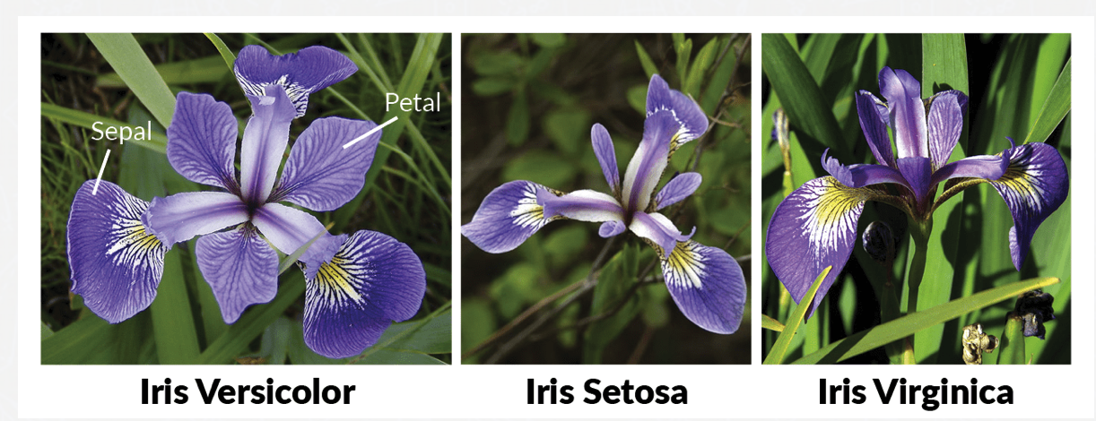
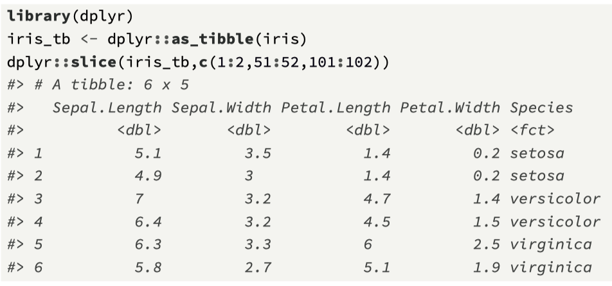
(1) The iris dataset
A collection of 150 observations based on data collected by the American botanist Edgar Anderson.
For three species of the iris flower (setosa, versicolor, and virginica) measurements (in cm) relating to the length and width of both the sepal, and the petal are recorded.
http://www.lac.inpe.br/~rafael.santos/Docs/CAP394/WholeStory-Iris.html

Slide 5
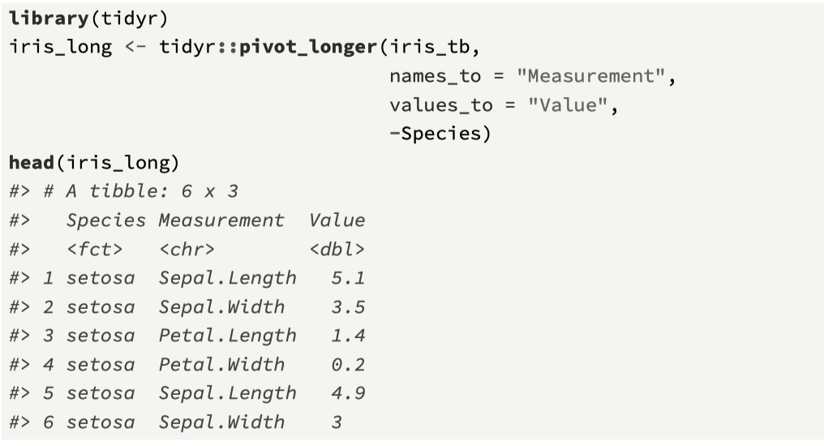
Convert to longer format to support visualisation

Slide 6
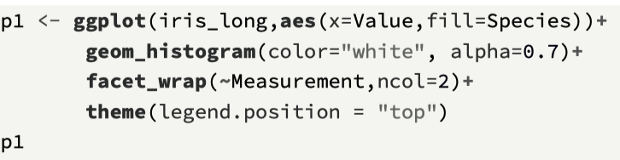
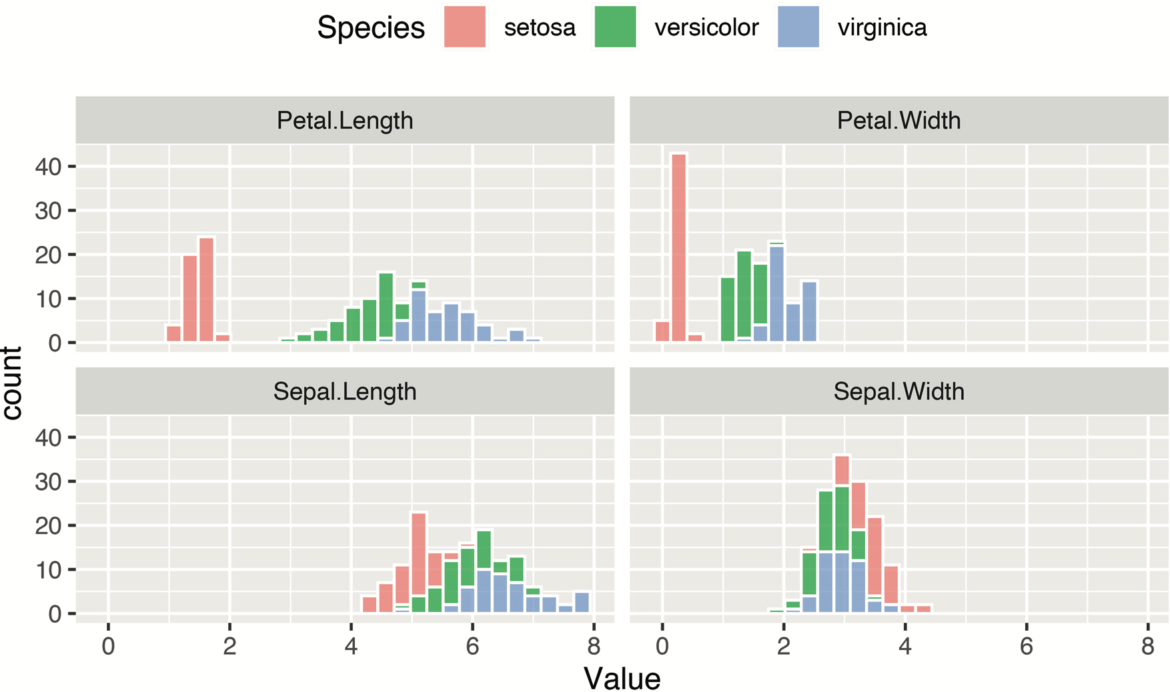
Visualise

Slide 7
Initial comments…
The petal variables visualized on the top row show a clearer separation between the species.
Specifically, for both the petal length and width, the setosa histogram plot is fully distinct from the other two.
There also seems to be a difference between the versicolor and virginica species.

Slide 8
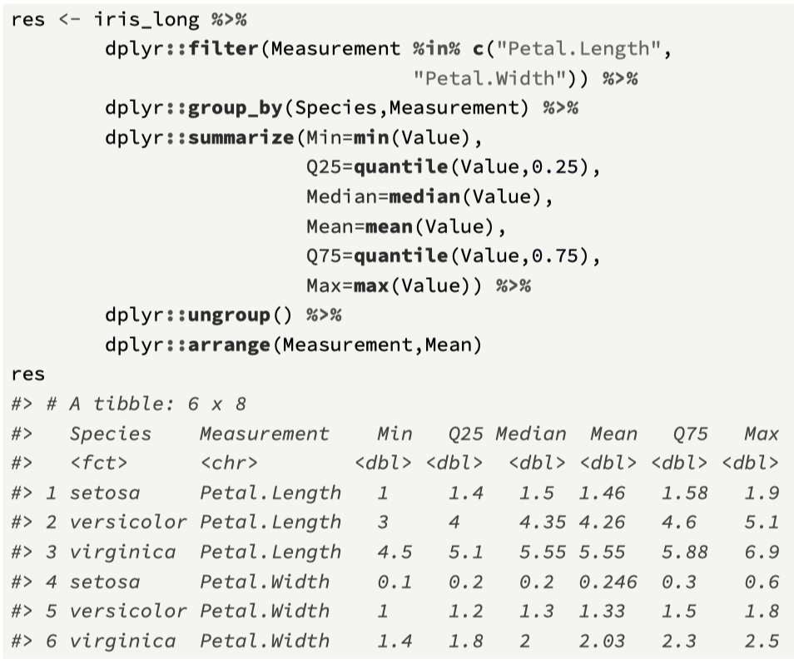
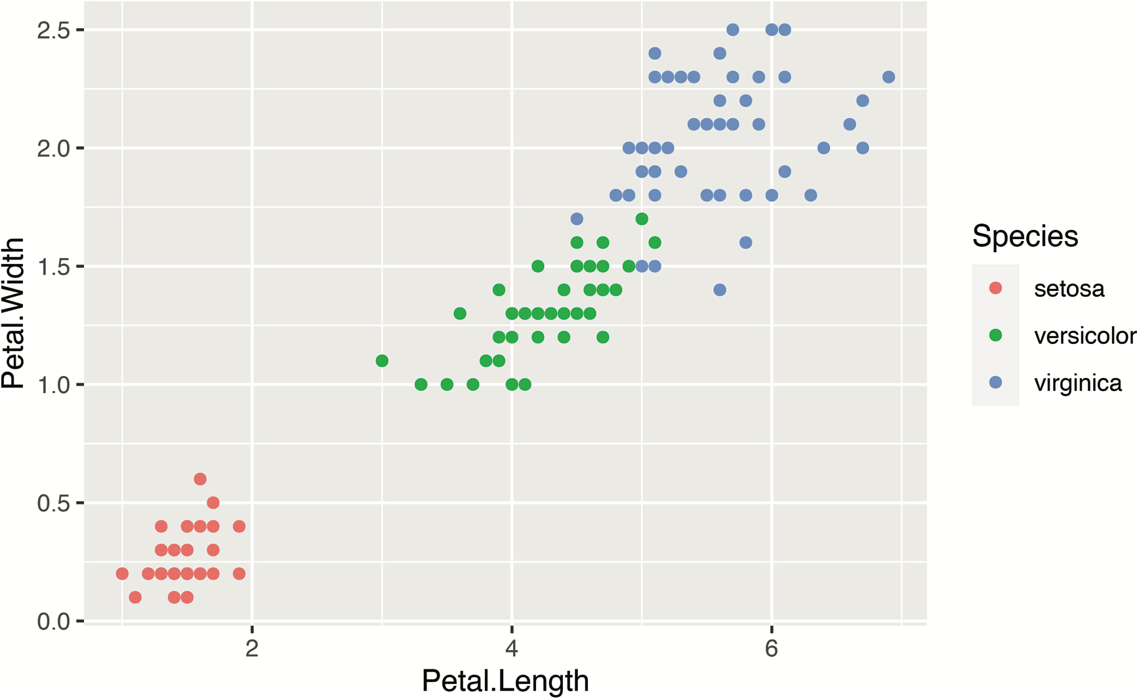
Another view

Slide 9
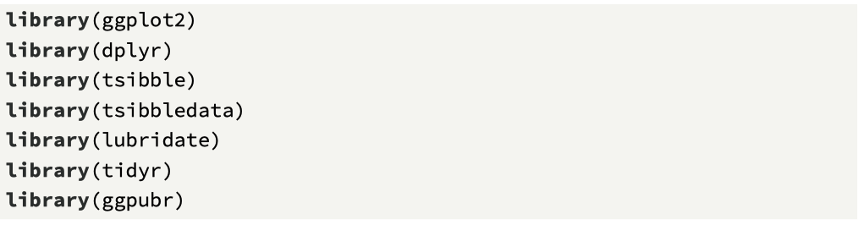
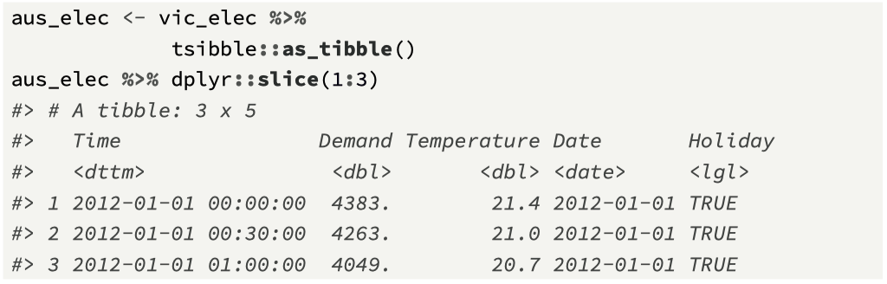
(2) Temperature and Energy Demand
Our next example focuses on time series data recorded in Victoria, Australia from 2012 through to 2014, and it can be accessed through CRAN (Hyndman and Athanasopoulos, 2021).
The dataset contains electricity demand values (megawatt hours) and the corresponding temperature levels (celsius) at 30 minute intervals.

Slide 10
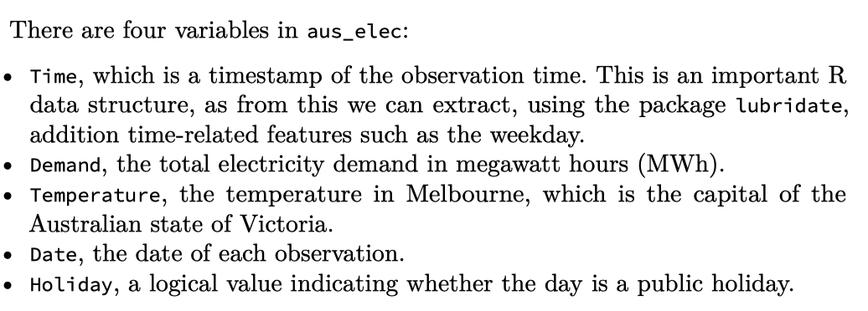
Available data

Slide 11
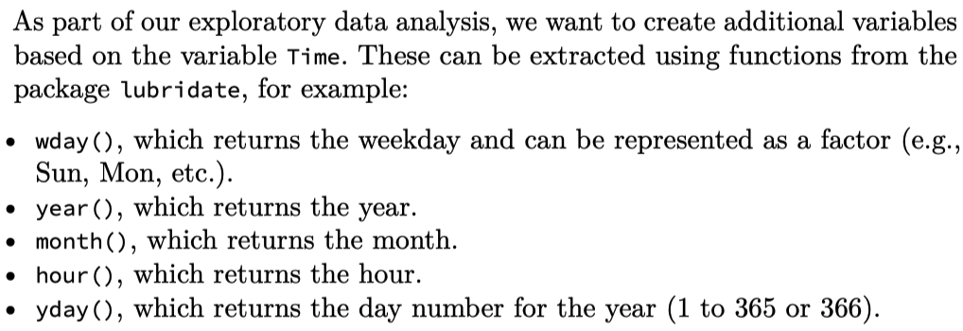
Variables added

Slide 12
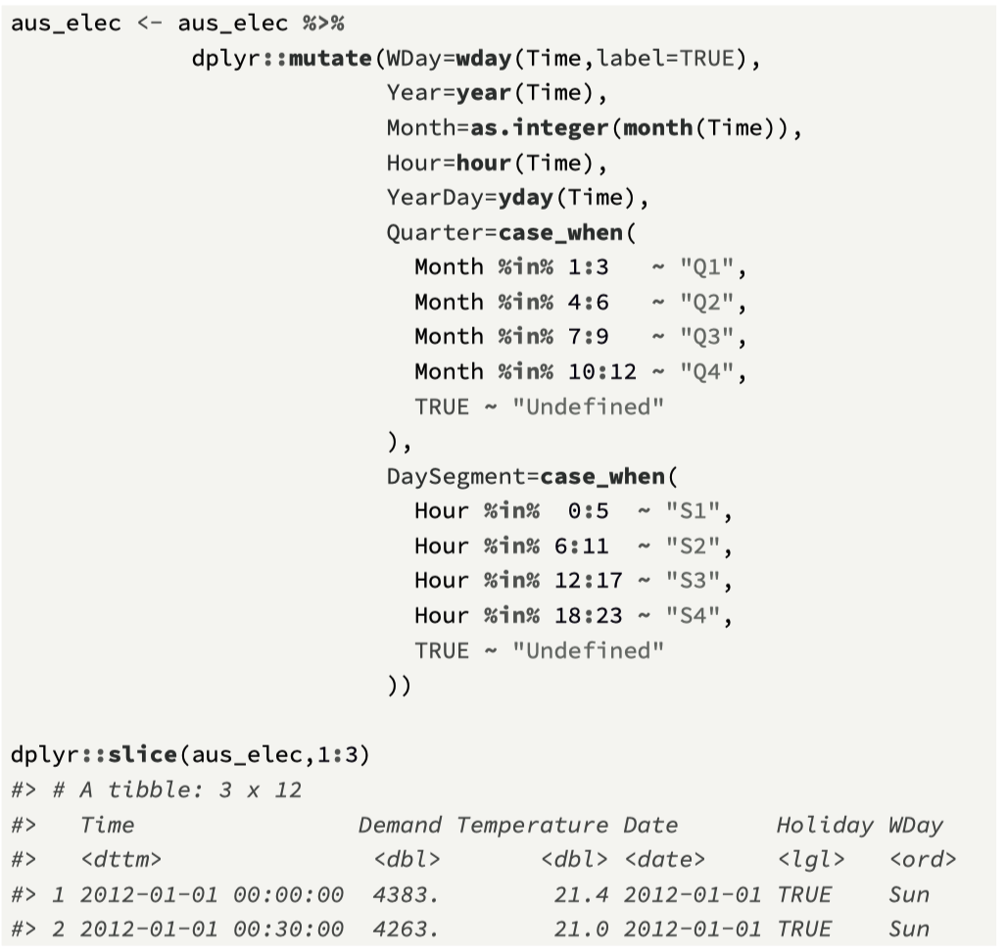

Slide 13
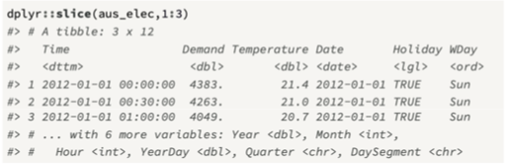
The resulting tibble…

Slide 14
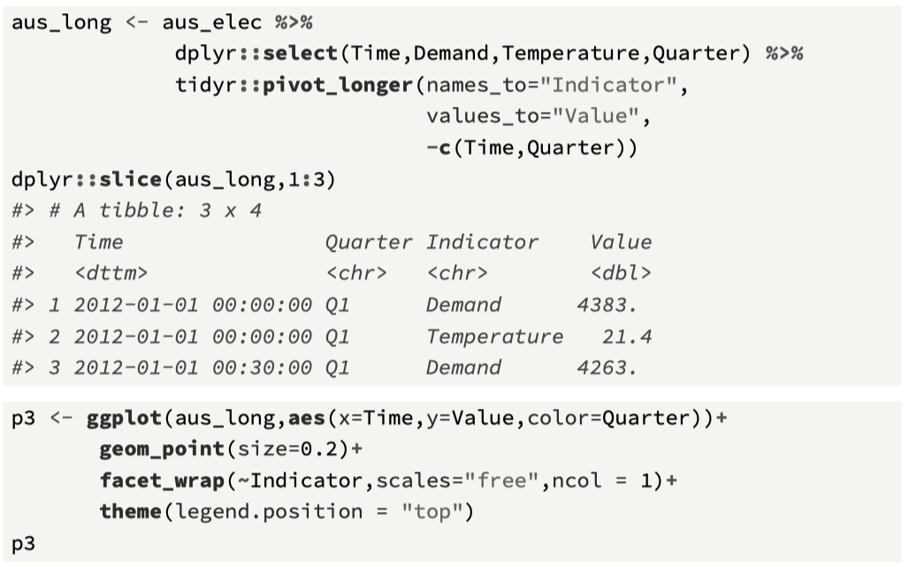
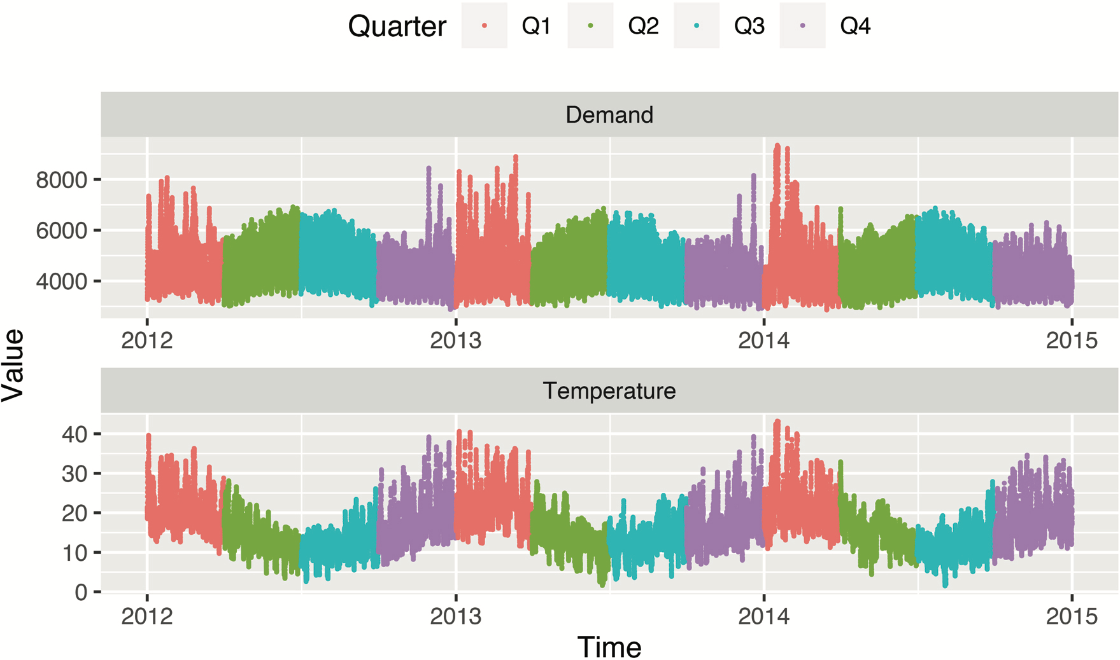
Exploring the time series…

Slide 15
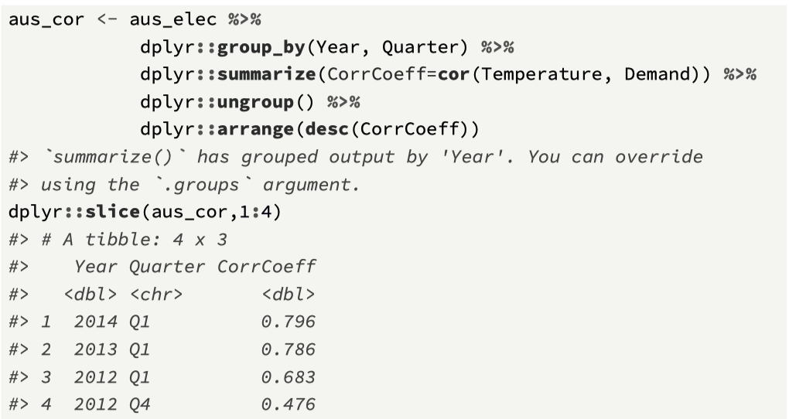
Correlation coefficient: Temperature, Demand

Slide 16
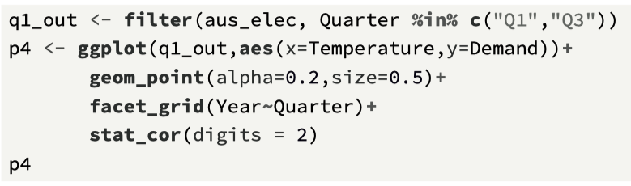
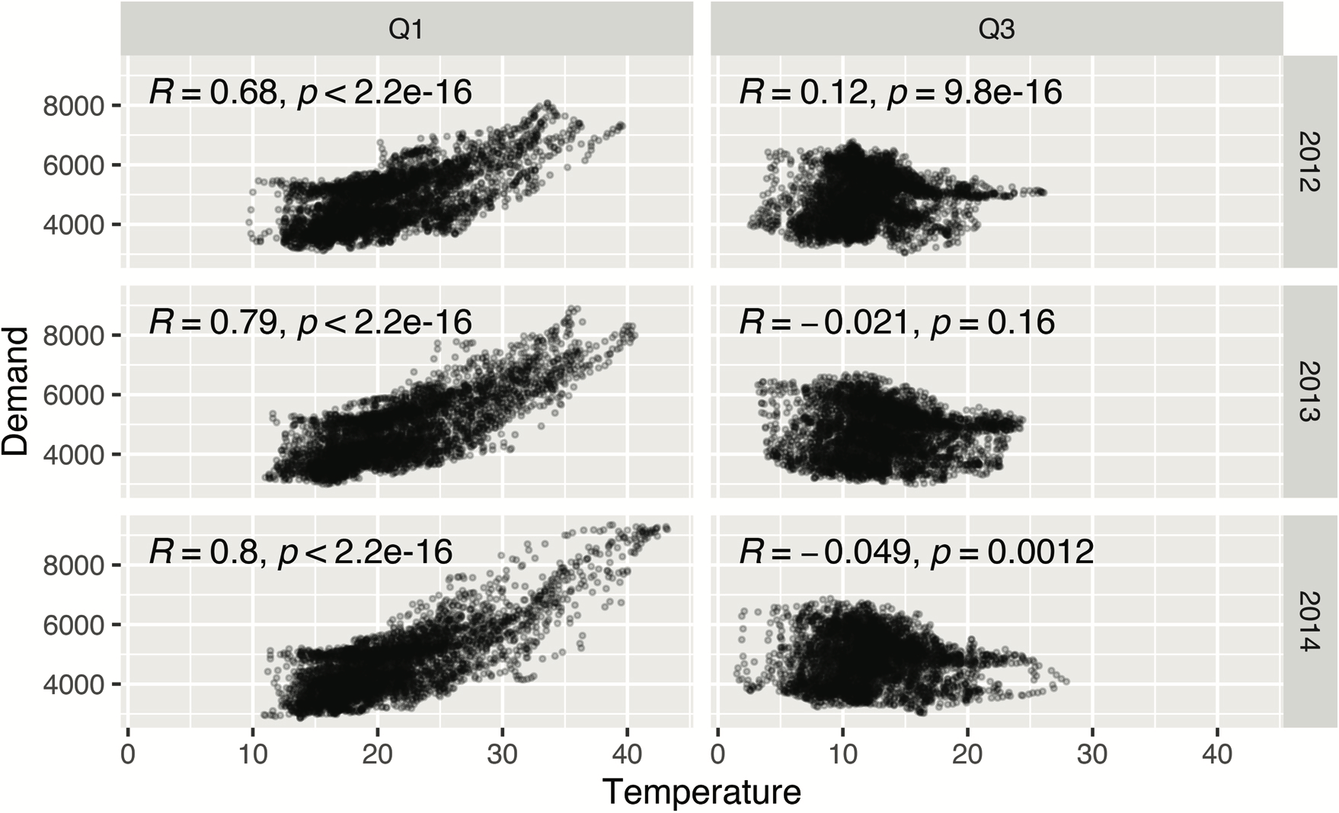

Slide 17
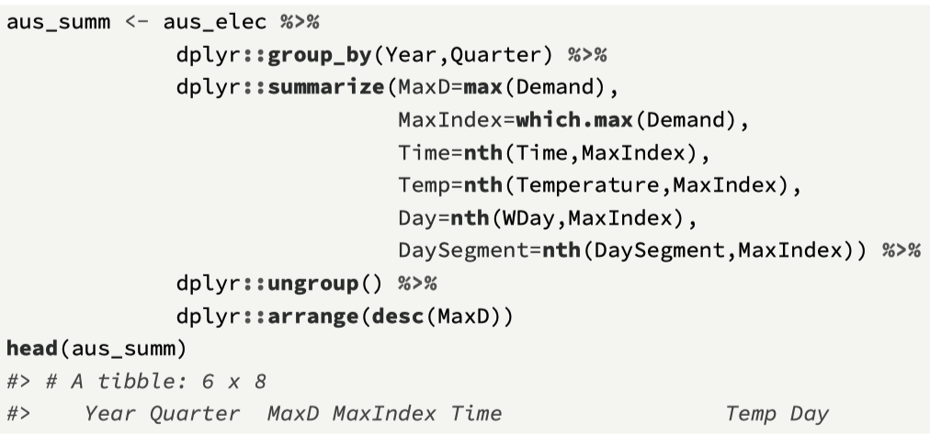
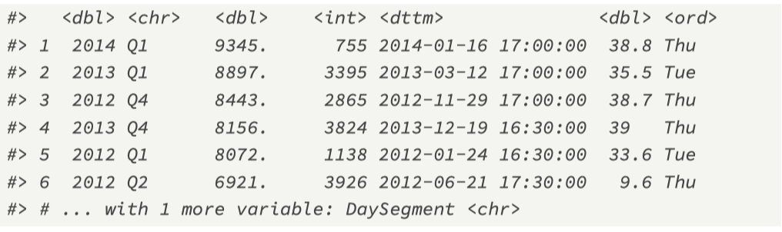
Maximum demand information: per year, quarter

Slide 18
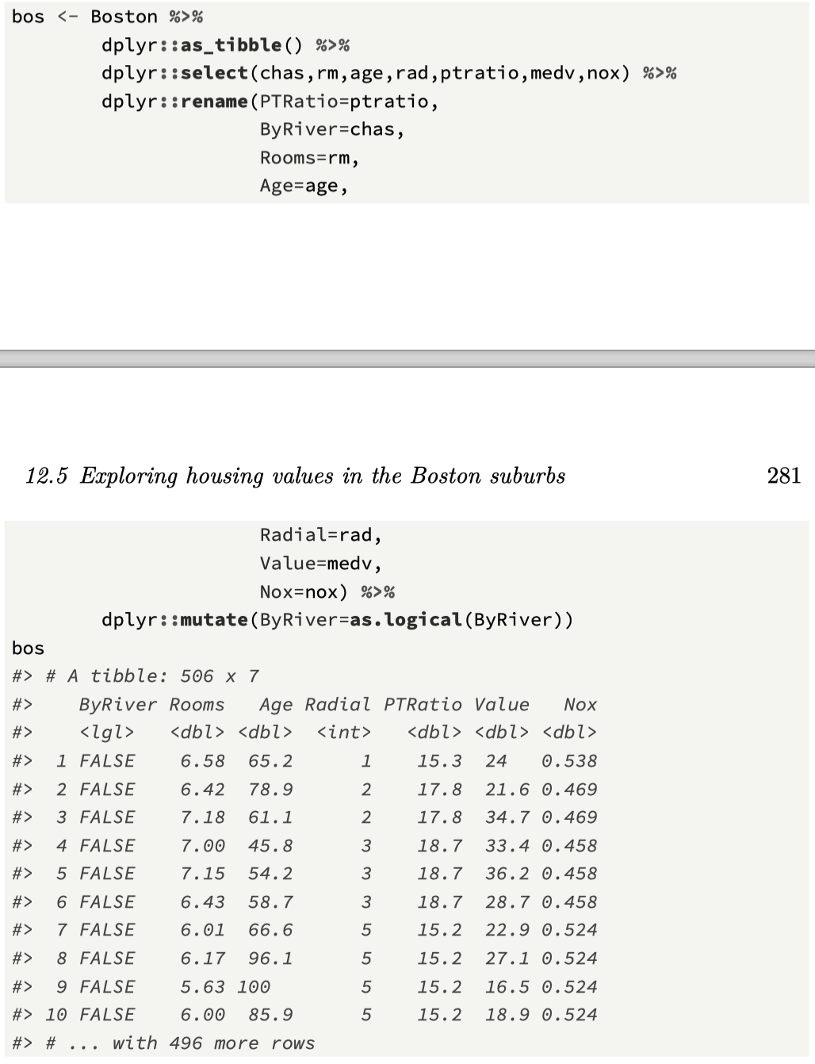
(3) Exploring Housing Values
Package MASS, Contains information on Boston suburb housing prices, and related variables, from the 1970s (Harrison Jr and Rubinfeld, 1978), including:
chas, a variable that indicates whether the area bounds the Charles River (1 = bounds, 0 otherwise).
rm, the average number of rooms per dwelling
age, the proportion of owner-occupied units built prior to 1940
rad, index of accessibility to radial highways.
ptratio, pupil–teacher ratio by suburb. 280
medv, the median value of owner-occupied homes (thousands of dollars).
nox, the nitrogen oxide concentration (in parts per million).

Slide 19
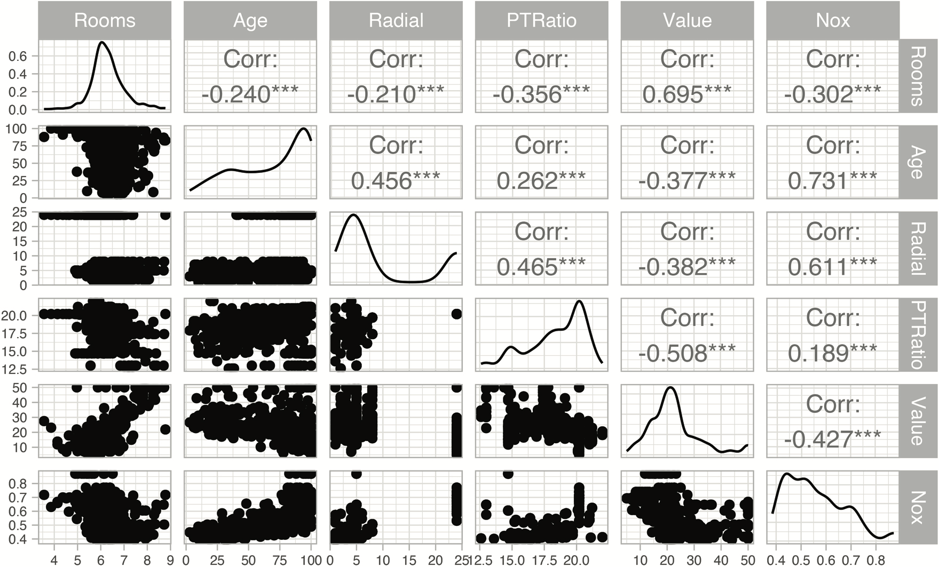
Pair-wise associations

Slide 20
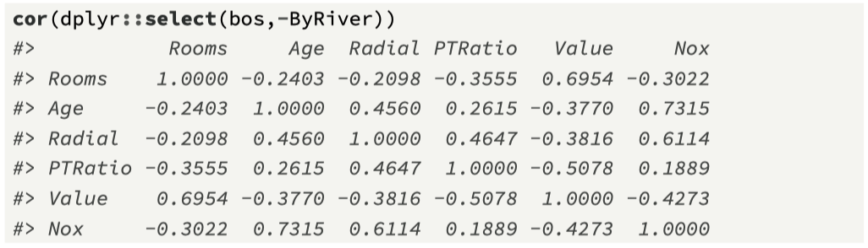
Exploring the correlation data…

Slide 21
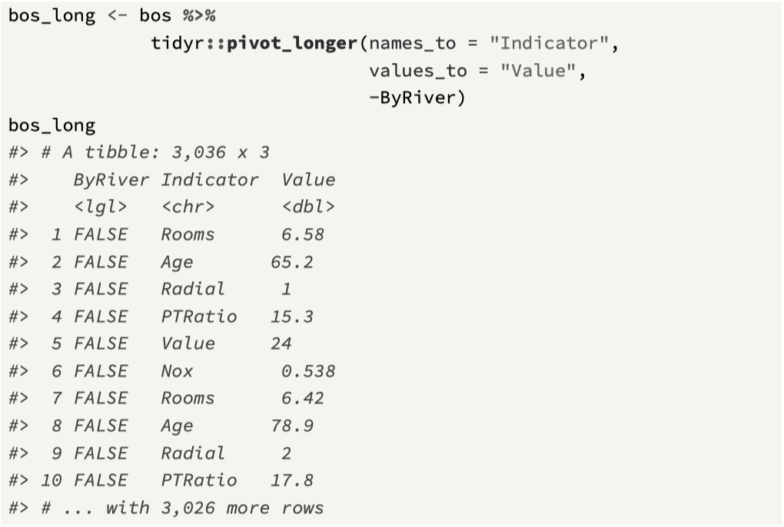
Transforming the data…

Slide 22
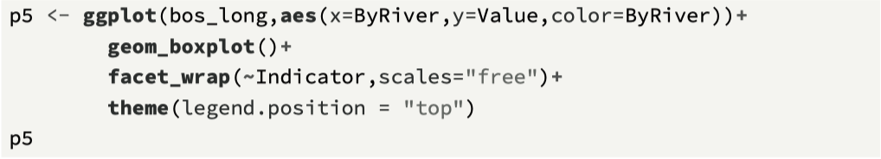
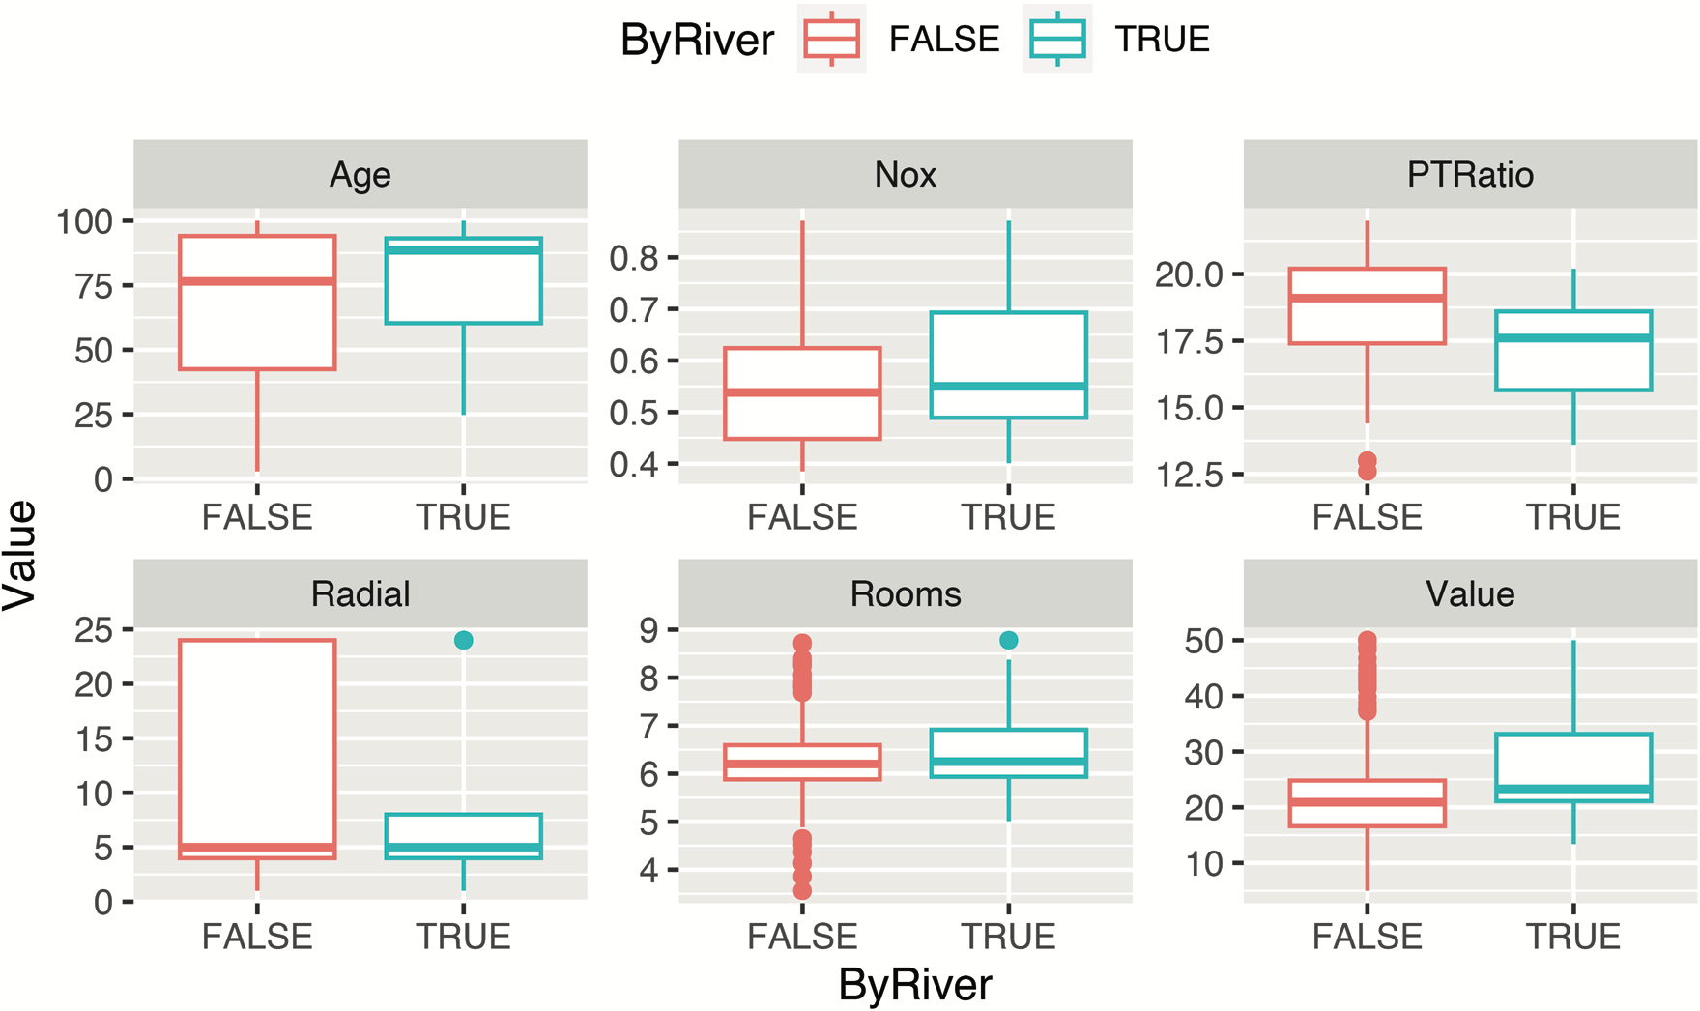

Slide 23
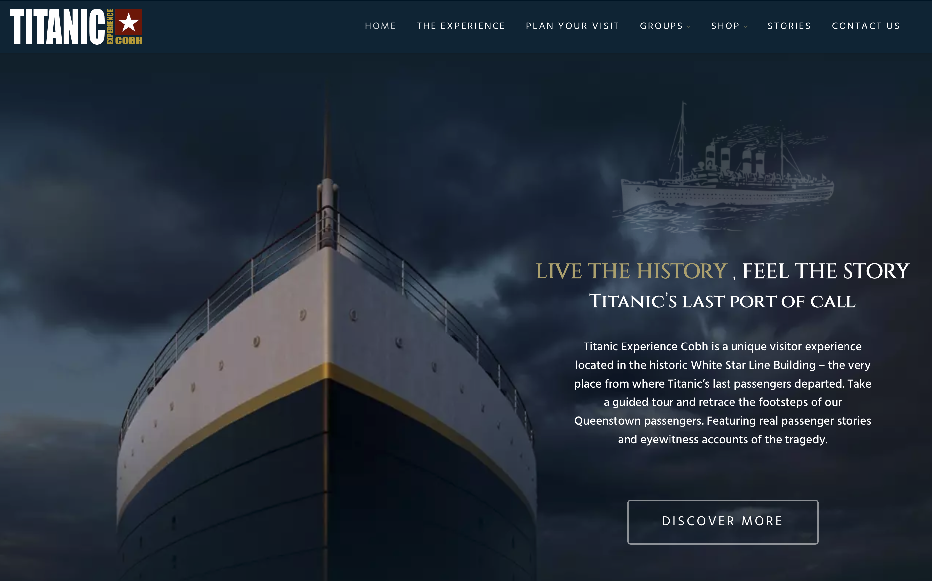
(4) Passenger survival on the Titanic
The Titanic was built in Belfast, and departed on its first voyage from Southampton on April 10, 1912, stopping in Cherbourg and Cobh, before setting sail across the Atlantic Ocean on route to New York.
On April 15, she struck an iceberg off the coast of Canada, and sank to the ocean floor.
Over 1,500 passengers and crew perished, with only about 700 surviving.
Electronic versions of the ship’s passenger list are now available, and have been used as case studies in order to explore survival outcomes of passengers
https://www.titanicexperiencecobh.ie

Slide 24
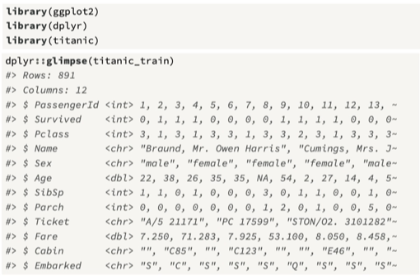

Slide 25
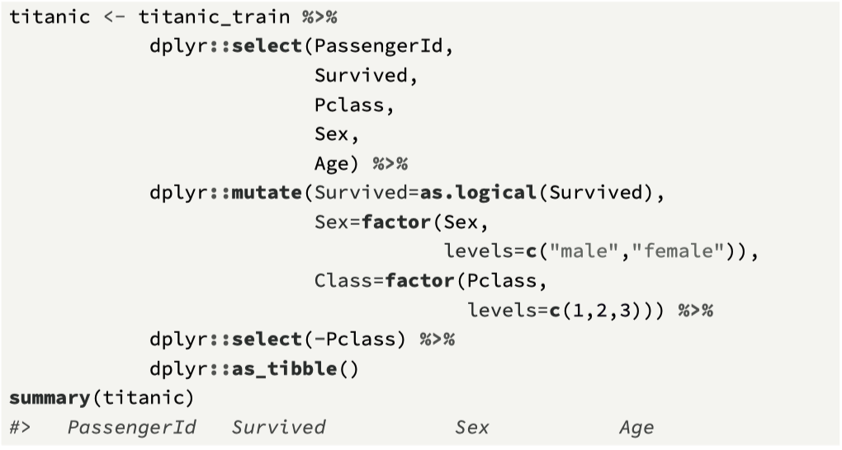
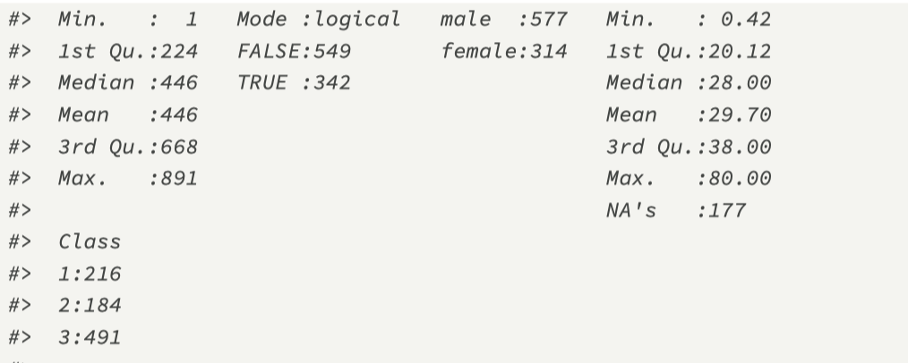

Slide 26
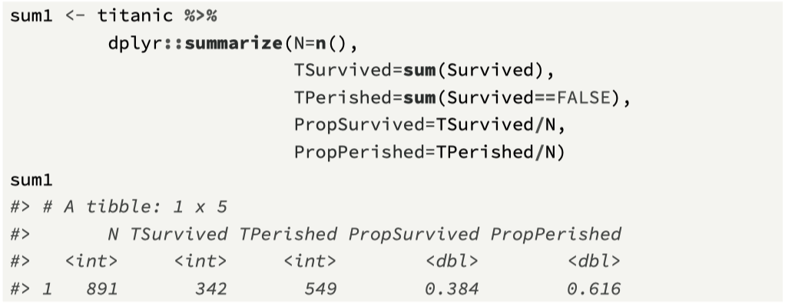
Overall summaries of the data.

Slide 27
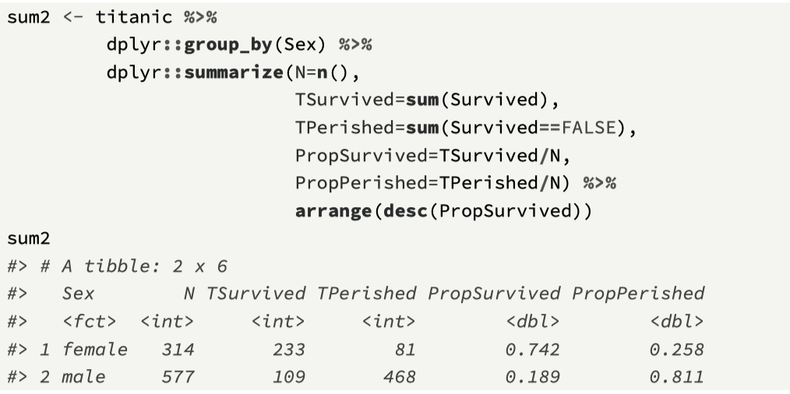
Exploring differences: male/female

Slide 28
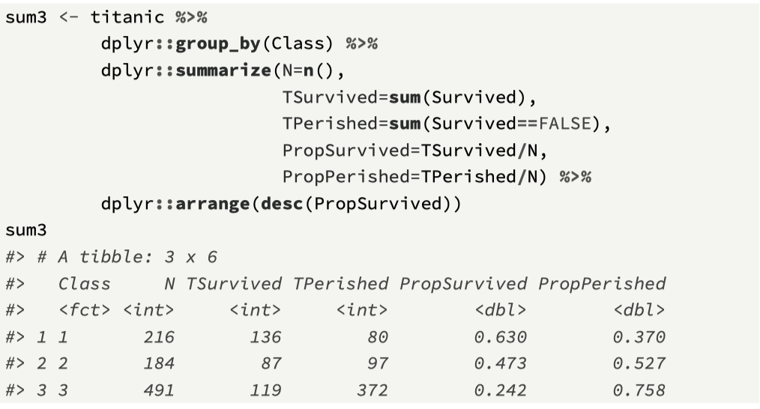
Exploring differences: 1st, 2nd, and 3rd class

Slide 29
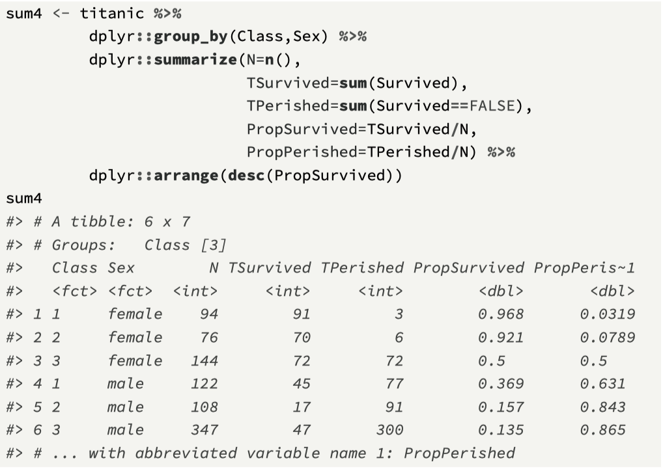
Differences by two groupings

Slide 30
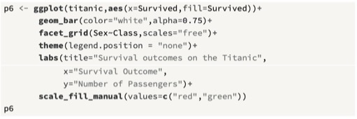
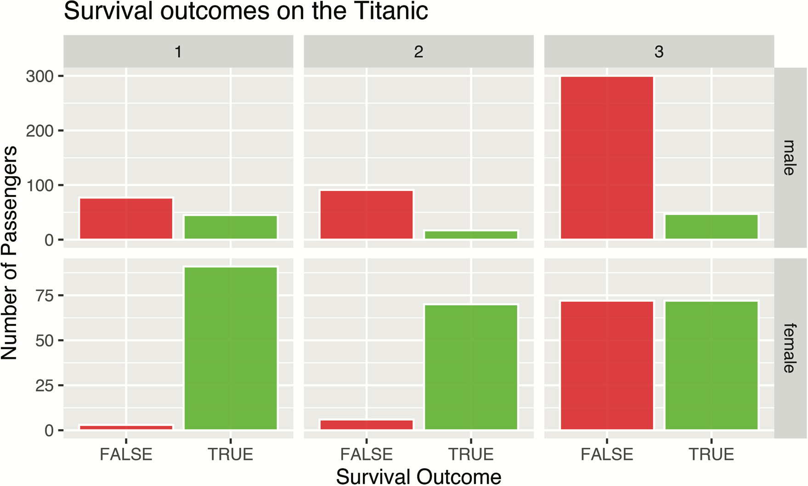

Slide 31
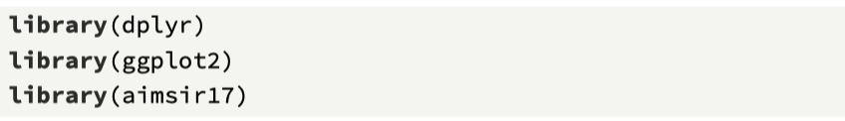
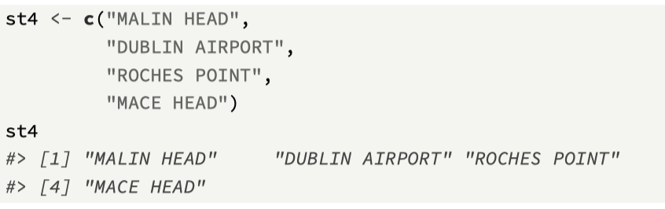
(5) Wind direction and winter temperatures
Our final example focuses on weather data, based on the tibble observations that is part of the aimsir17 CRAN data package.
Our question is to explore whether, in winter, wind from a southerly direction is more associated with higher temperatures.

Slide 32
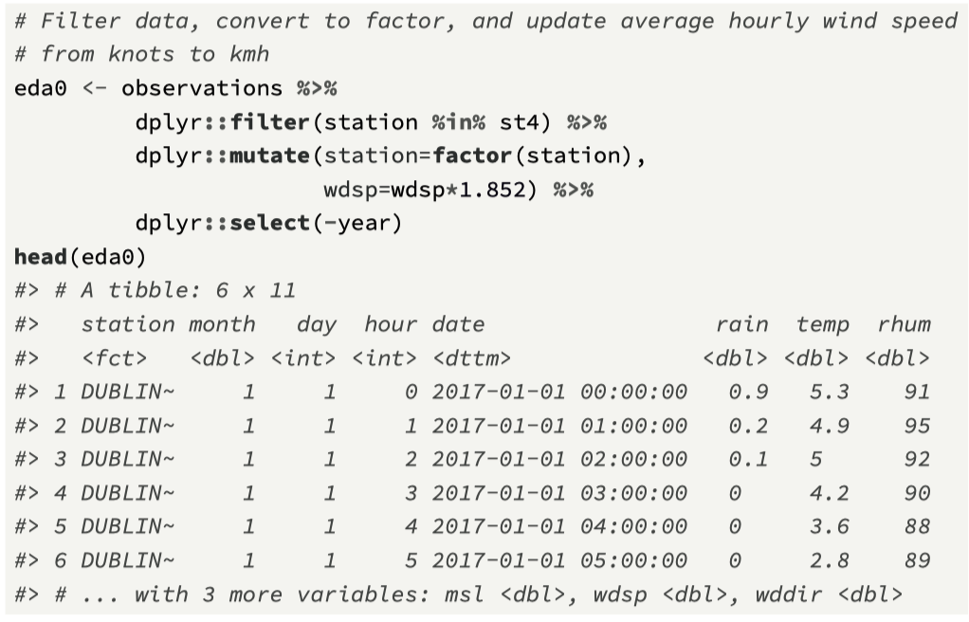
Filter 4 stations and modify wdsp to kmh

Slide 33
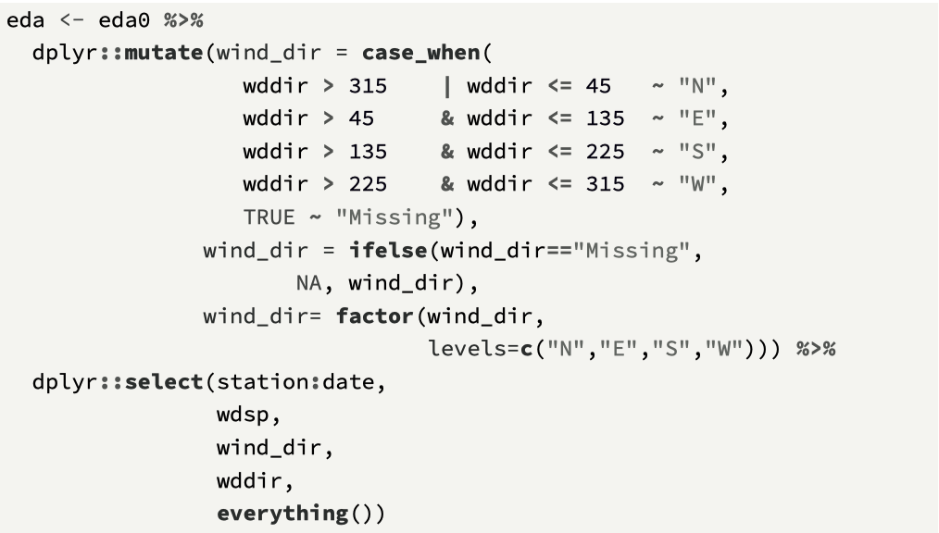
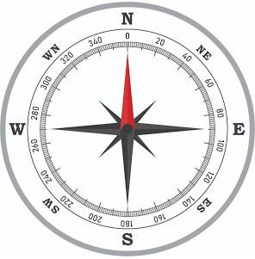
Add wind direction as NESW

Slide 34
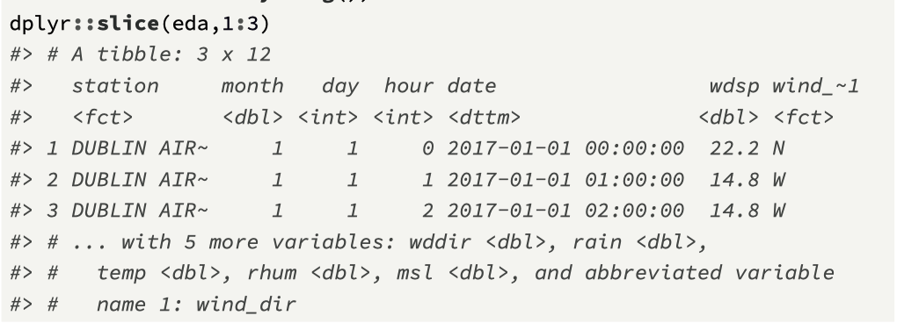
Show the resulting tibble

Slide 35
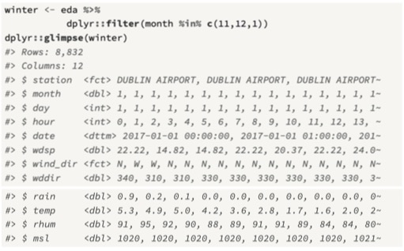
Filter by winter month (10, 11, and 1)

Slide 36
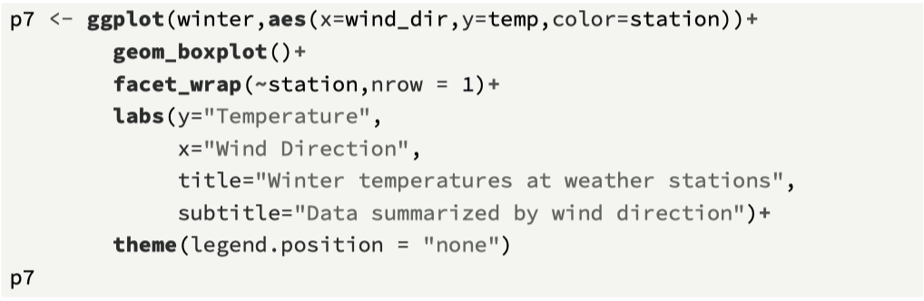
ggplot() call

Slide 37
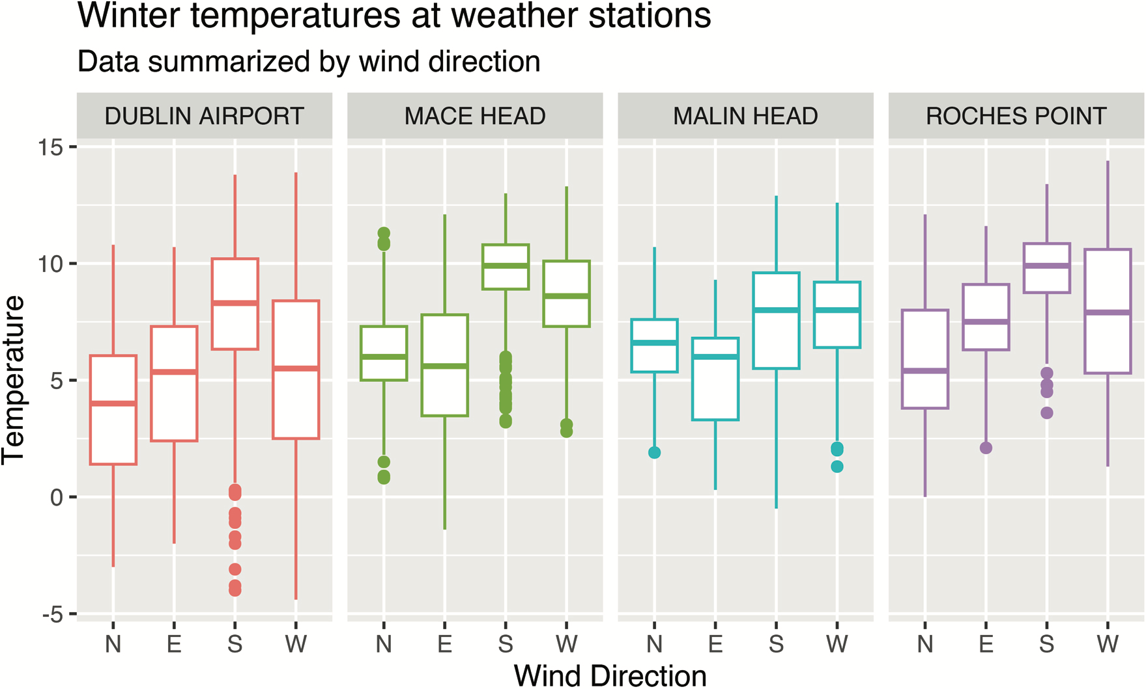
Visualisation

